Slide 1
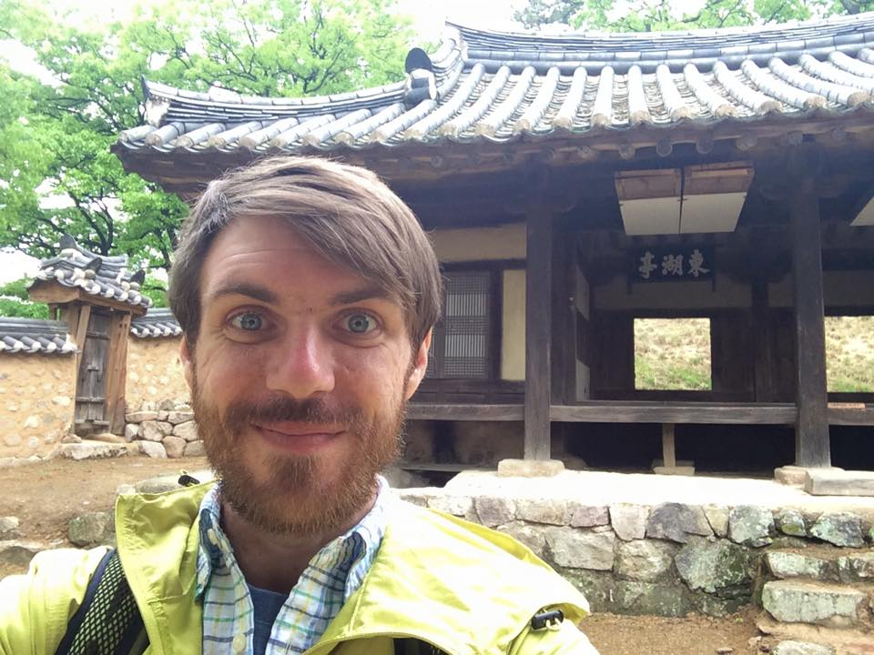
Diversity in Korea A multicultural Pedagogy
Name: Jeremy Schramm
Current Position: English Teacher
Current Residence: South Korea
Education:
BFA in illustration from Ringling College of Art and Design
Working on MA in Art Education from University of Florida

Slide 2
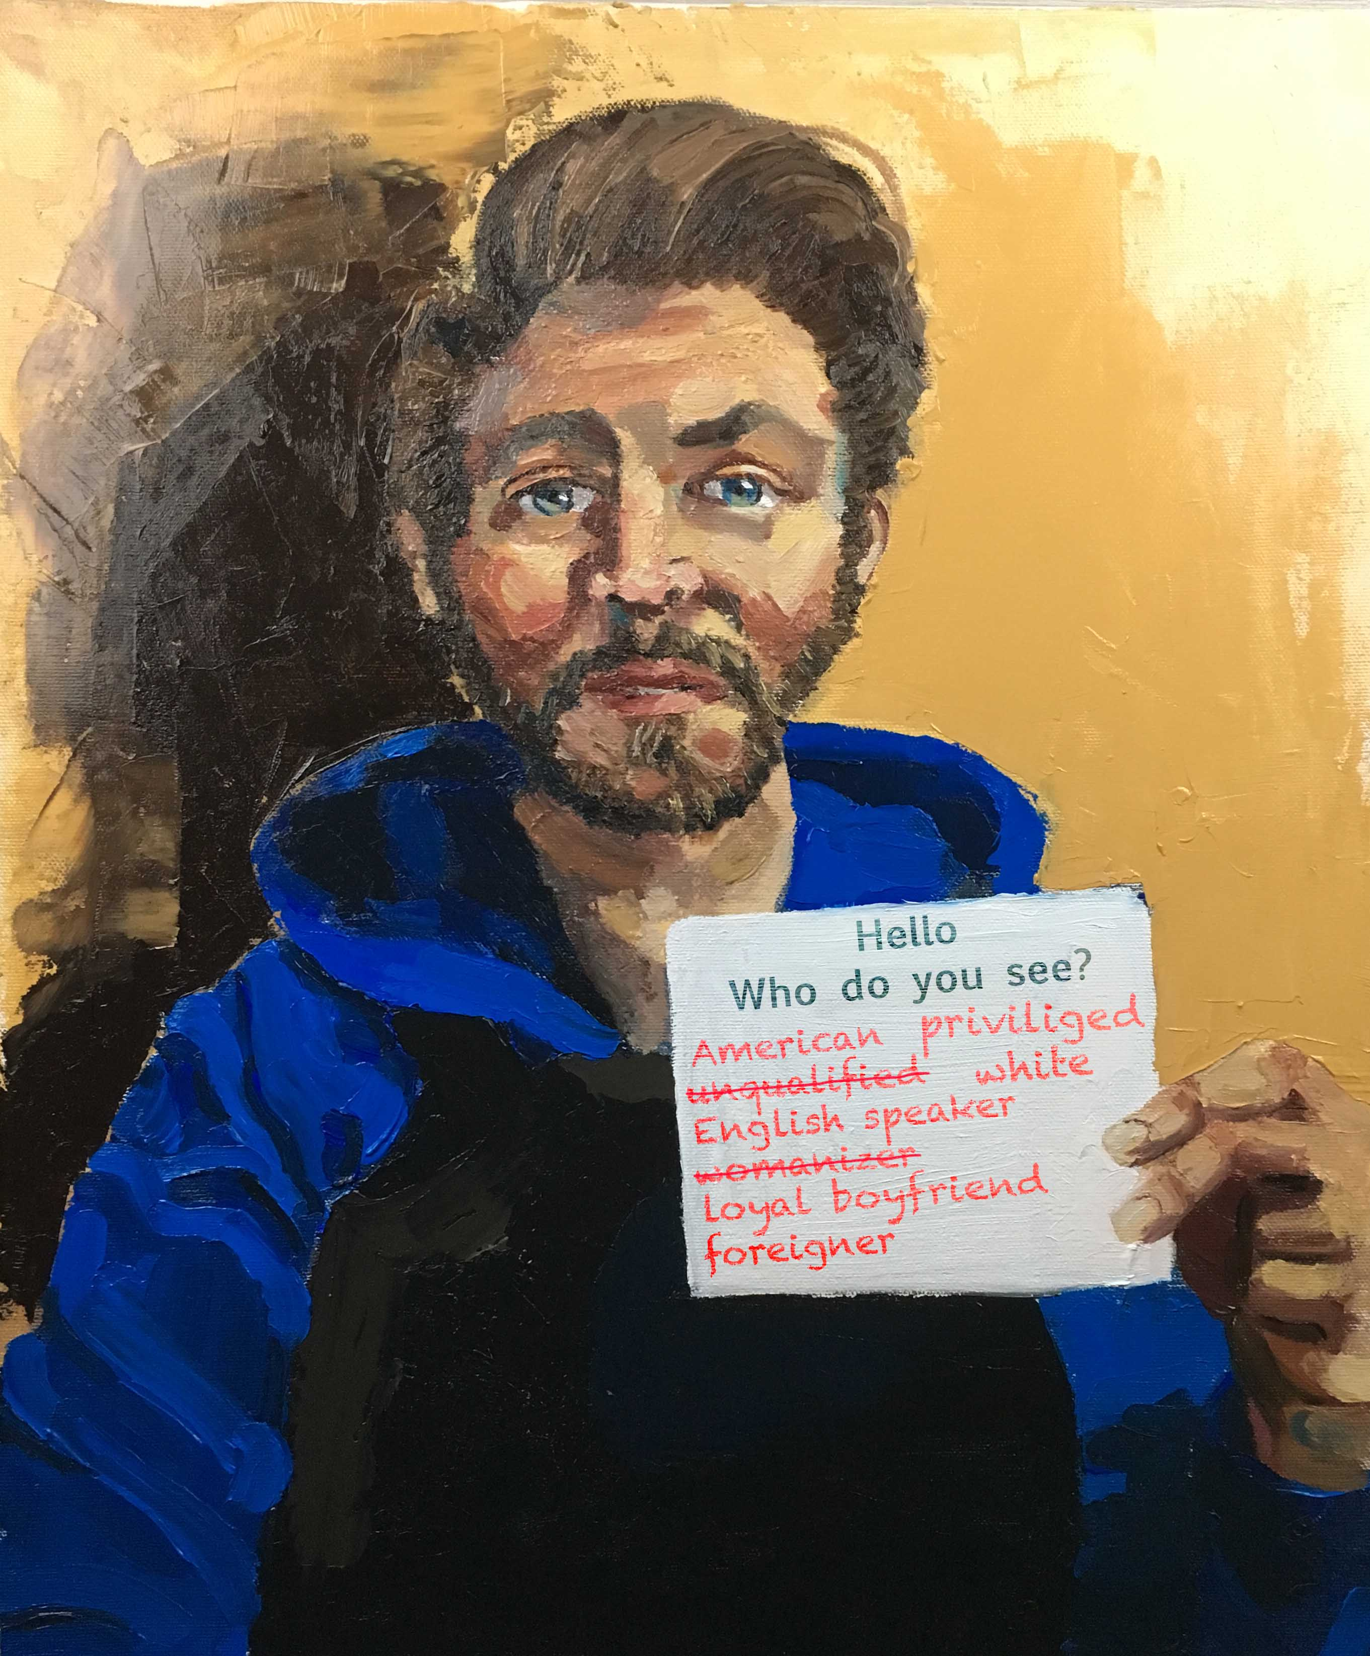
Jeremy Schramm
Who do you see?
Oil on Canvas
2017

Slide 3
Synopsis
A View of Korean history examining Korea’s closed boarders policy and the events that led to its forced opening.
A look into some common stereotypes and bias in Korea of foreigners.
An exploration of multicultural pedagogy

Slide 4
Relevant & Informative
Understanding of the history the developed the modern day Korea and the recent increase of immigrants
Multicultural Pedagogy

Slide 5
Questions & Issues
Creating artwork that is not racialized stereotyped
Balance of when to allow students to talk out issues or when to take control of the conversation

Slide 6
www.jeremyschramm.com

